Slide 1



Software Engineering CS411, FALL 2025
Lecture 4: Requirements Documentation by Dr. Mohamad Kassab
Leonidas Kontothanassis kthanasi@bu.edu

Slide 2
Lesson plan
Forms of Representing Requirements.
Problems with Requirements.
The Requirements Document
IEEE 29148 qualities for requirements.
Additional Best Practices to represent requirements.

Slide 3


How to Write down Requirements?
The Three Forms of Requirements Representation
Various techniques can be used to describe functionality in any system. Generally, there are three forms of requirements representation
Informal
Semi-Formal
Formal
Requirements specifications may not strictly adhere to one or another of these approaches, but usually, they contain elements of at least two of these approaches (informal and one other).

Slide 4
Informal Representation
This form includes natural language (i.e., human languages), flowcharts, ad hoc diagrams, etc.
Natural language is in fact the most common form of requirements for projects in the industry.
In a recent survey by Kassab and Laplante , it was found that 69% of projects reported that requirements were expressed in terms of natural language, that is, informally.
There are different ways to express requirements in natural languages. For example:
Shall Statement
Use Cases
User Stories
Quality Scenarios
Notes:
Shall Statements: The traditional way for writing requirements in IEEE 29148
Use cases: Functional behavior of system (functional requirements)
User stories: Similar to use cases but user rather than system centric
Quality scenarios: Non-functional requirements

Slide 5
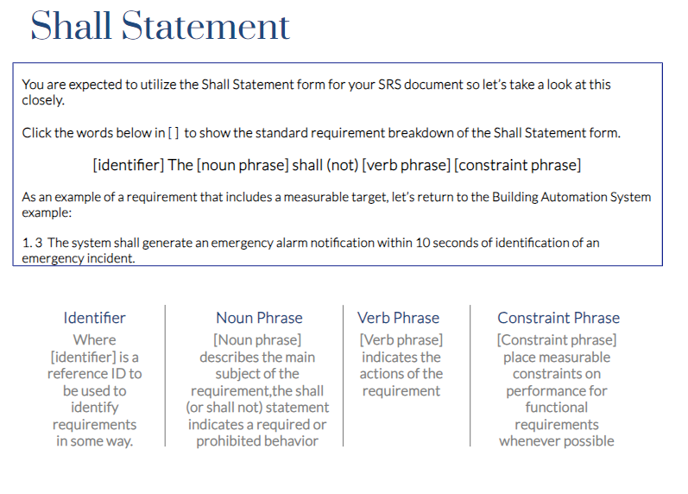

Slide 6
Shall Statements
IEEE 830, ISO/IEC/IEEE 29148, and common industry practice distinguish verbs as follows:
Shall or Must: A binding mandatory requirement
Should: A desirable or recommended but not mandatory requirement
May: A permission or option but neither a recommendation or obligation
Other verbs are avoided (more on that later)

Slide 7
Use Cases
A use case is a group of related scenarios that provide value to the user of a system where a scenario is one of many paths within a use case.
Use cases of the system can be visualized through the UML Use Case diagram. UML diagrams are considered a semi-formal notation.
We will discuss more the use cases later in the lecture.
The following slide shows an example of a use case that describes how users would interact with a smart home system.

Slide 8
A Use Case Example
Primary Base Use Case: Controlling home temperature.
Precondition: A user has a number of smart sensors and actuators installed in their home.
Main Success Scenario:
A user with a cell phone wants to know the temperature in their home.
They connect to the cloud to query their home sensors.
After verifying their identity, the system presents a set of options based upon the sensor/actuator package installed in their home.
The user selects the temperature option and received the temperature of their home from the cloud.
The user decides that they would like to cool the home prior to his arrival.
The user sends a command to the home via the cloud to turn on the air conditioner along with a specified set temperature.

Slide 9
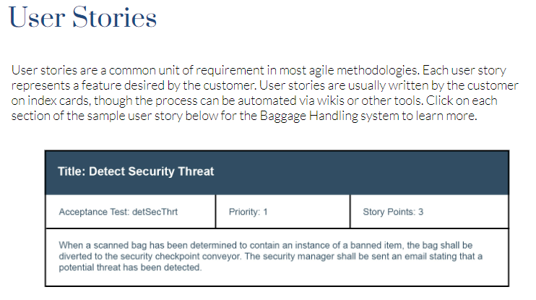

Slide 10
Semi-Formal
This form includes those that, while appearing informal, have at least a partial formal basis.
For example, many of the diagrams in the Unified Modeling Language (UML) or Systems Modeling Language (SysML) family of metamodeling languages including the use case diagram are semiformal or can be formalized.
The UML is a set of modeling notations that are used in software and systems engineering requirements specification, design, systems analysis, and more.
In this course, we will introduce a number UML diagrams at different phases of the development.

Slide 11
FORMAL
Formal notations such as Z and VDM rely on mathematical formalisms to represent requirements.
Based on set theory and first order predicate logic
We won’t explore these further in this course.
Notes:
First order logic. Think operators like for all, exists, implication, equivalence etc.

Slide 12
VDM++ example
-- File: BankAccount.vdmpp class BankAccount instance Variables balance : real := 0 owner : seq of char;
---------------------------------------------------------------- -- Class invariant: a balance can never be negative ---------------------------------------------------- inv (balance >= 0) ---------------------------------------------------- -- Constructor: create an account with an owner name ---------------------------------------------------- operations public BankAccount : seq of char ==> BankAccount BankAccount(nm) == ( owner := nm; balance := 0 ) pre nm <> [] -- non-empty name post owner = nm and balance = 0; ---------------------------------------------------- -- Deposit money ---------------------------------------------------- public deposit : real ==> () deposit(amount) == balance := balance + amount pre amount > 0 post balance = old balance + amount; ----------------------------------------------------
-- Withdraw money ---------------------------------------------------- public withdraw : real ==> () withdraw(amount) == balance := balance – amount pre amount > 0 and amount <= balance post balance = old balance - amount; ----------------------------------------------------
-- Pure query function ---------------------------------------------------- functions public getBalance : () -> real getBalance() == balance; ---------------------------------------------------- -- Simple synchronisation: at most one -- withdraw or deposit may proceed at a time ---------------------------------------------------- sync per withdraw => not busy; per deposit => not busy; values busy : bool = false; end BankAccount

Slide 13
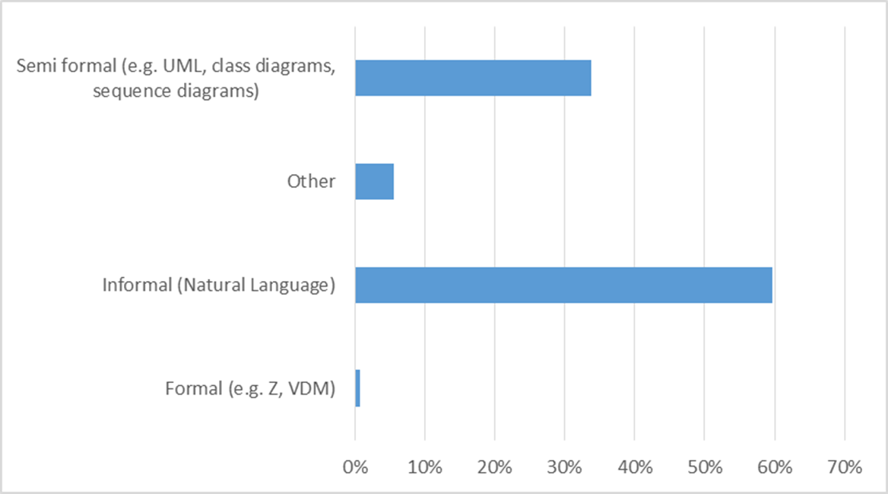
Requirements Representation in practice
Kassab, M., & Laplante, P. (2022). The current and evolving landscape of requirements engineering in practice. IEEE Software, 39(5), 76-83.

Slide 14
Our focus today…
In this lecture, we will focus more on informal representation of requirements.
In particular, we will focus on requirements representation in the form of “Shall Statements” and “Use Cases”.
You will use a combination of these formats moving forward in your assignments and project deliverables.

Slide 15
Shall statements for medical record system
Patient Information Management:
The system shall allow authorized users to create, view, update, and delete patient records.
The system shall store patient information, including but not limited to personal details, medical history, medications, allergies, and treatment plans.
Access Control:
The system shall require users to authenticate using a username and password before accessing the system.
The system shall assign roles to users, with each role having specific permissions (e.g., administrator, physician, nurse).

Slide 16
Shall statements for medical record system
Audit Trail:
The system shall log all access and modifications to patient records, including the user ID, timestamp, and type of action performed.
The system shall allow authorized users to view audit logs for compliance and monitoring purposes.
Data Security:
The system shall encrypt patient data both in transit and at rest to ensure confidentiality.
The system shall automatically lock user sessions after a period of inactivity to prevent unauthorized access.
Interoperability:
The system shall support the exchange of patient information with other healthcare systems using HL7 or FHIR standards.
The system shall allow the import and export of medical records in standard formats, such as XML or JSON.

Slide 17
What is wrong with these requirements?
The system shall not permit access to unauthorized users.
The system shall permit access only to authorized users.
The system shall be completely reliable.
The number of pieces of baggage lost by the system shall be minimal.

Slide 18
Problems with Requirements
Requirements can be
Confusing
Extraneous
Duplicated
Conflicting
Missing
Requirements analysis – determine if the above
Requirements agreement – techniques to deal with these

Slide 19

The Requirements Document
Is the official statement of what is required of the system developers
It is a contract (and enforceable by law)!
Should include both a definition and a specification of requirements
It is NOT a design document. As far as possible, it should set of WHAT the system should do rather than HOW it should do it.
There are many documentation formats
There is no best documentation format – it all depends sponsor, on the situation, customer, application domain, etc.

Slide 20
Users of a Requirements Document
Specify the requirements and read them to check that they meet their needs. They specify changes to the requirements
Customers
Don’t forget lawyers, judges, plaintiffs, juries, district attorneys, arbiters, mediators, etc., who will view the SRS as a legal document in the event of disputes.
Use the requirements document to plan a bid for the system and to plan the system development process
Managers
Developers
Use the requirements to understand what system is to be developed
Test engineers
Use the requirements to develop validation tests for the system
Maintenance engineers
Use the requirements to help understand the system and the relationship between its parts

Slide 21

ISO/IEC/IEEE Standard 29148
In 2011, three international standardization bodies, the International Standards Organization (ISO), the International Electrotechnical Commission (IEC), and the Institute for Electrical and Electronics Engineers (IEEE) jointly released the ISO/IEC/IEEE Standard 29148 (2011). In 2018, the second edition of ISO/IEC/IEEE Standard was released. The standard is based on a model that produces a document that helps:
to establish the basis for agreement between the acquirers or suppliers on what the product is to do;
to force a rigorous assessment of requirements before design can begin and reduce later redesign;
to provide a realistic basis for estimating product costs and risks, and schedules organizations to develop validation and verification plans;
to provide an informed basis for deploying a product to new users or new operational environments;
to provide a basis for product enhancement.

Slide 22
ISO/IEC/IEEE Standard 29148
The IEEE 29148 outline is particularly beneficial to the requirements engineer because it has been widely deployed across a broad range of application domains
Because of all the above, our course has adopted the IEEE 29148 standard as a template for your team project.
In particular, you will need to follow the template for your SRS (Software Requirements Specification) document (Delivery 2). The template is an adaptation of IEEE 29148.
Notes:
Important Rules to comply with Standard
Follow the requirements engineering process defined in the standard (elicitation → analysis → specification → validation → management).
Ensure all requirements meet the listed quality characteristics.
Document requirements in an SRS (or SyRS) that follows the standard’s structure.
Maintain traceability (link requirements ↔ design ↔ test cases ↔ stakeholder needs).
Control changes using a requirements management process.
Apply verification & validation criteria to confirm requirements are both correct and testable.

Slide 23
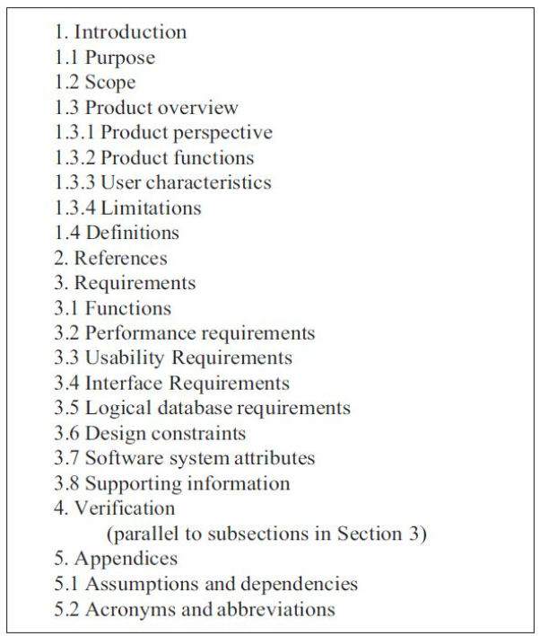
Table of Contents for an SRS

Slide 24
SRS Document
1. Introduction
Purpose – Why this software exists; what problem it solves.
Scope – What the software will do, and what it won’t do (boundaries).
Definitions, acronyms, abbreviations – To avoid ambiguity.
References – Standards, regulations, supporting documents.
Overview – Short description of the system context.
2. Overall Description
Product perspective – Context diagram or explanation of how the system fits into a larger environment.
Product functions – High-level summary of capabilities.
User characteristics – Who will use the system, their expertise level.
Constraints – Regulatory, hardware, network, design limitations.
Assumptions and dependencies – Conditions taken as true, or external factors.
3. Specific Requirements
This is the core of the SRS — often the longest section.
Functional requirements (often expressed as shall statements, sometimes grouped by feature/use case).
3. Cont’d
Interfaces (user interfaces, hardware interfaces, software interfaces, communication protocols).
Performance requirements (response time, throughput, scalability).
Logical database requirements (data models, schemas, consistency rules).
Design constraints (e.g., must run on Windows, must use Oracle DB).
Standards compliance (e.g., must comply with ISO 26262).
4. Non-Functional Requirements (Quality Attributes)
Reliability
Availability
Security
Usability
Maintainability
Portability
5. Verification and Validation
How each requirement will be verified (test, analysis, inspection, demonstration).
6. Appendices
Supporting information, traceability matrix, glossaries, or domain models.

Slide 25
Organizational Options for section 3.1
System mode (e.g., navigation, combat, diagnostic)
User class (e.g., user, supervisor, diagnostic)
Object (by defining classes/objects, attributes, functions/methods, and
messages)
Feature (describes what the system provides to the user)
Stimulus (e.g., sensor 1, sensor 2, actuator 1, …)
Functional hierarchy (e.g., using a top-down decomposition of tasks)
Notes:
This is how to organize your requirements:
System mode: If the system has different modes
User class: By user type interacting with the system
Object: Around objects in the system
Feature: By features visible to users
Stimulus: Based on inputs/events
Functional Hierarchy: Based on higher level broken down to lower level requirements
Complex reactive systems → System Mode or Stimulus.
Multi-role systems → User Class.
Object-oriented projects → Object.
Customer-facing products → Feature.
Highly functional decompositions → Functional Hierarchy.

Slide 26
IEEE Std 29148 Considerations for requirements
For a single requirement
Singular
Feasible
Unambiguous
Complete
Consistent
Verifiable
Traceable

Slide 27
IEEE Std 29148
For a set of requirements
Complete
Consistent
Bounded
Affordable

Slide 28
Singular
Each requirement specifies a single and have no conjunctions.
3.1.1 The pump control unit shall start the submersible pump motors to prevent the wet well from running over and stop the pump motors before the wet well runs dry.
versus:
3.1.1.1 The pump control unit shall start the submersible pump motors to prevent the wet well from running over.
3.1.1.2 The pump control unit shall stop the pump motors before the wet well runs dry.
Conjunctions can be used if they describe a single behavior
3.2.6 The light emitted by the display shall be either red or yellow.

Slide 29
Feasible
A requirement that can be satisfied with current technology and cost constraints,
Not a ridiculous requirement.
Examples
The system shall consume no power.
The length of the beam shall be less than 0 feet.

Slide 30
Unambiguous
A requirement is unambiguous if it can have only one interpretation.
Example
If the valve is open and the drain is open, then it should be closed.
Conjunctions can cause ambiguity and that is why they should be avoided.

Slide 31
Complete
A requirement is complete “to the extent that all of its parts are present and each part is fully developed.”
Switch 1 shall have two positions, one position is “on”.
Same property for a set of requirements
E.g. no “TBD”

Slide 32
Consistent
A requirement is consistent if it does not contradict itself (internal) or a prevailing standard or law (external).
If the lever is in position 1 then it shall open and close the valve.
Same for a set of requirements (e.g.)
3.1 If the lever is in position 1, then valve 1 is opened.
3.2 If the lever is in position 1, then valve 1 is closed.

Slide 33
Verifiable
Satisfaction of the requirement can be demonstrated
The system shall be user friendly
Usually needs metrics associated with the requirement
Important to always envision the acceptance test along with the requirement
Goal-question-metric paradigm useful

Slide 34
Traceable
Numbered or indexed somehow
Essential quality for effective communications ease of modification, and legal considerations.
Stored in a requirements management tool

Slide 35
Traceability Matrix
Req ID | Requirement Statement | Source | Design Element | Code Module | Test Case(s)
REQ-001 | The system shall require login with username/password. | Stakeholder Need #12 | Authentication Screen | auth_controller.py | TC-01: Valid login TC-02: Invalid login
REQ-002 | The system shall lock an account after 5 failed attempts. | Security Policy SP-03 | User Account Manager | user_service.py | TC-03: Lock after 5 failures
REQ-003 | The system shall encrypt all user passwords using AES-256. | GDPR, NIST 800-63 | Encryption Module | crypto_utils.py | TC-04: Verify AES-256 hash
REQ-004 | The system shall support password reset via email. | Stakeholder Need #15 | Password Reset Service | reset_handler.py | TC-05: Reset email sent TC-06: Reset success
REQ-005 | The system shall provide response times < 200 ms for queries. | Performance Req PR-01 | Database Query Layer | db_query.py | TC-07: Response time test

Slide 36
Bounded
A set of requirements is bounded if it does not exceed the scope of the system intent.
Important to avoid scope creep.
Refer to mission statement (or conops) to avoid scope creep;
e.g. does this requirement fit the mission?

Slide 37
Affordable
For a set of requirements meets budgetary constraints.
Affordability analysis discussed later

Slide 38
Ranked
Not a 29148 mandated quality, but…
Important for design decisions, tradeoff analysis, budget negotiations and more
Rank can be ordinal (1, 2, 3, …) or subjective (high, medium, low), or based on need (mandatory, desirable, optional)
Two requirements can hold the same rank
Ranking is part of the requirements agreement process

Slide 39

Best Practices

Slide 40
Shall or Must?
Notes:
Are applicable” (context-setting, not enforceable)
“These encryption requirements are applicable to all modules handling sensitive data.”
Used to scope requirements, but does not itself impose an obligation.
“Is required to” (formal obligation, but more verbose than “shall”)
“The payment service is required to log all failed transactions.”
Equivalent in meaning to “shall,” but less standard in contracts. Often used when describing roles or responsibilities.
“Must” (obligation, but discouraged in formal specs)
“All passwords must be at least 12 characters long.”
Strong like “shall,” but IEEE prefers “shall” for legal clarity. “Must” is fine in policies or user guidance.
“Responsible for” (assigning duties, not always testable)
“The database administrator is responsible for ensuring daily backups are performed.”
Defines accountability, not necessarily a system behavior. More common in process/role documents than software requirements.
“Shall” (preferred word for mandatory, testable requirements)
“The system shall generate an audit log entry for each login attempt.” Canonical wording in contracts and formal SRSs. Implies mandatory, testable behavior.
“Should” (recommendation, desirable but not mandatory)
“The UI should display error messages in the user’s preferred language.” Indicates a goal or preference; not a compliance failure if unmet. Used for non-binding requirements.
“Will” (declaration of intent or future fact, not a requirement)
“The next release will include support for biometric login.” Used for planning/roadmap statements, not verifiable requirements. Some orgs misuse it in place of “shall,” but standards discourage that.

Slide 41
Best Practices
Use language in a consistent way.
Use “shall” for mandatory requirements,
Use “should” for desirable requirements
Use text highlighting to identify key parts of the requirement.
Avoid the use of technical language unless it is warranted.

Slide 42
Shall Not Requirements
Can be rewritten in positive form. Ex
The system shall not harm humans.
Alternative
The system shall cause humans no harm.

Slide 43
Avoid The Following
Hedging words/clauses:
If necessary
Almost
Probably
Maybe
Might be
Conjunctions:
Speculative terms:
Vague terms
And
Or
But
Perhaps
sometimes
User friendly
generally

Slide 44
Bad Habits in Requirements Specification
Mixing of operational and descriptive specifications.
Combining low-level hardware functionality and high level systems and software functionality in the same functional level.
Omission of timing information.

Slide 45
Best Practices
Bad:
The system shall be completely reliable.
The system shall be modular.
The system will be fast.
Errors shall be less than 99%.
Better:
Response times for all level one actions shall be less than 100 ms.
The cyclomatic complexity of each module shall be in the range of 10 to 40.
95% of the transactions shall be processed in less than 1 s.
MTBF shall be 100 hours of continuous operation.

Slide 46

Weak Phrases
Lead to uncertainty due to multiple interpretations:
Adequate
As a minimum
As applicable
Be able to
Be capable
But not limited to
Capability of
Capability to
Effective
If practical
Normal
Provide for
Timely
TBD
Source: Rosenberg

Slide 47
Use Cases
Let’s focus now on how to write requirements in Use Cases.

Slide 48
Online Checkout (Main Success Scenario)
Customer navigates to the Shopping Cart page and clicks “Proceed to Checkout.”
System displays the Order Review page, showing items, quantities, and pricing.
Customer confirms or edits delivery address and payment details (credit card, etc.).
System processes the payment by calling a Payment Service.
Payment Service returns approval to the System.
System finalizes the order, generates an order ID, and sends a confirmation email to the Customer.
Customer sees a confirmation message on the screen with the order details

Slide 49
Online Checkout (Alternative Scenarios (Extensions))
(1a) Customer Not Logged In: 1a.1. The System detects the user is not logged in. 1a.2. The System prompts the user to log in or create an account. 1a.3. Upon successful login, the use case continues from Main Success Scenario step 2
(3a) Invalid Payment Details: 3a.1. The System detects invalid or incomplete payment details. 3a.2. The System displays an error message asking the Customer to re-enter correct payment details. 3a.3. After re-entry, the use case resumes from Main Success Scenario step 3.
(4a) Payment Declined: 4a.1. The Payment Service returns a declined status (e.g., insufficient funds). 4a.2. The System notifies the Customer and requests an alternate payment method. 4a.3. Customer either cancels the order or enters new payment details. 4a.4. If new payment details are valid, the use case returns to step 4 in the Main Success Scenario. If the user cancels, the order is not placed, and the use case ends in failure.
(6a) Email Service Unavailable: 6a.1. The System fails to send the confirmation email. 6a.2. The System logs the error and queues the email for later sending. 6a.3. The use case otherwise completes normally (the order is still placed and the Customer sees the on-screen confirmation).

Slide 50
What is a use case?
A group of related scenarios that provide value to the user of a system
A scenario is one of many paths within a use case
Main Success Scenario
Alternate Scenarios
Mechanism for projects to organize requirements in a way that makes them easy to find, understand, change, critique, test, verify and deliver incrementally.
Notes:
The use case technique is used in software and systems engineering to capture the functional requirements of a system.
A use case is a text story
ATM system may require 3 scenarios: withdrawal, deposit, transaction

Slide 51
Use case modeling elements
Define Actors
Define top level use case diagram
Define use case diagrams
Define use cases
Example
A University wants to create an online registration system. The University registrar sets up the curriculum, students register for courses and the professors request course rosters.
Notes:
Lets define the modeling elements by going through an example.

Slide 52
Actors
External entities that interact with a system
They define a role played by entities when they interact with a system
many entities may play the same role or an entity may play many roles
Example
Registrar
Professor
Student
Notes:
Use cases describe the interaction between a primary Actor (the initiator of the interaction) and the system itself, represented as a sequence of simple steps.
Actors are something or someone which exist outside the system under study, and that take part in a sequence of activities in a dialogue with the system to achieve some goal. They may be end users, other systems, or hardware devices. Each use case is a complete series of events, described from the point of view of the Actor.

Slide 53
Top Level Use Case Diagram
Shows interface between actors and the system
Determines the scope of the system by clearly defining its boundary
Also referred to as the system context diagram
Example
Registrar
Registration
System
Student
Professor
Notes:
Context diagram shows the boundary of a system- what lies outside of it and how it gets used

Slide 54
Use Case Diagrams
A Use Case Diagram shows a set of external actors and the use cases each actor participates in
Use the top level use case diagram to identify use cases
For each primary actor,
identify their goals (Elementary Business Processes)
Identify how they use the system (Scenarios)
Consistently size use cases and scenarios
Too many: increased modularity, reduced functional complexity, complex configuration management, complex coordination, complex schedule
Example
Maintain Curriculum
Registrar
Student
Register for Course
Professor
Request Course Roster
Notes:
Scenario: a specific sequence of actions and interactions between actors and the system
You don’t’ want too many scenarios – on one hand it will reduce the complexity of the system – on the other hand it will be difficult to coordinate and schedule the design of the system.

Slide 55
How to document Use Cases?
Use Cases can be :
Fully Dressed : Highly structured, covering all sections (e.g., scope, level, pre-conditions, main success scenario, extensions, special requirements, etc.).
Partially Dressed: A simpler structure—often bullet points summarizing the main success path followed by alternative flows.

Slide 56
Fully Dressed Use Case Template (Larman’s Template)
Use Case Name
Scope
Level
Primary Actor
Stakeholders and Interests
Pre-Conditions
Success Guarantee (success end condition)
Main Success Scenario
Extensions
Special Requirements
Technology & Data Variation List
Frequency of Occurrence
Open Issues/miscellaneous
Link to the fully dressed template

Slide 57
Main Success Scenario
The main success scenario
Focus on what not on the how
Do not repeat pre-conditions
Example
1. Registrar enters the semester
2. System presents course catalog
3. Registrar selects a course
4. System prompts for course offerings
5. Registrar assigns sections and times
Registrar repeats steps 3-5 until done
6. System saves the semester curriculum
Notes:
A typical, unconditional happy path scenario of success

Slide 58

Extensions
Alternate scenario paths such as
Exception conditions (failure conditions)
Alternate scenarios of success
Example
*a. At any time system fails
1. Registrar starts again from the point of failure
2a. Incorrect semester
1. System signals error and rejects entry

Slide 59
For your Assignment 1, Deliverable 2:
For your Assignment 1:
You will write requirements in “Shall Statements” format in section 5
For Section 6, You will then select five major requirements and rewrite them in use cases format. we recommend at least the following sections to be included for every use case:
Use Case Title
Main Success Scenario
Extensions (Alternative or Failure Scenarios)
For your Project Deliverable 2, you will write all your requirements in “Shall Statements” format.

Slide 60


Readings , Assignments, Project Tasks
Read:
Chapter 5 of the textbook.
Read IEEE 29148 Template at https://github.com/jam01/SRS-Template/blob/master/template.md. (This is your template for project delivery 2 as well)
Assignments & Project Tasks:
Project Delivery 1 is due Friday.
Assignment 1 is open (Due next Friday). This is an Individual Submission.

Slide 61
Poll: https://piazza.com/class/mcf8iluri7n5wk/

Slide 62

Questions?

